Slide 1
Orchestration Server (ORS) Basic 3 Delivery Training March 2017

Slide 2

Delivery

Slide 3
CCS Technology Training Matrix – Basic Overview
Category | Level of Competency upon completion of level | Assessment | Training Type | Duration
Basic 1 | No hands-on experience and have Webster's understanding | None | PPT - 1 for all org | 1 hour
Basic 2 | Introductory understanding of all capabilities of the service; understand the requirements needed to "configure/build" the service | 3 question assessment after class | PPT - 1 for all org | 1.5 hours
Basic 3 | Perform basic configuration/development tasks; read/understand the requirements to identify any omissions | Know how to log in to non-prod Can perform a basic development step Save your work. | PPT - 1 deck for platform and 1 deck for delivery | 1 day
Basic 4 | Understanding upstream inputs; understanding monitoring; Basic problem solving capabilities; understand the requirements to be able to build a solution; can perform basic support and development tasks | Articulate what is passed to the service Articulate the monitoring; check logs basic understanding of what is in the log Basic understanding of common issues PASSES PROFICIENCY TEST Can be on-call Work tickets Do basic development | PPT - 1 deck for platform and 1 deck for delivery | 2 days
3

Slide 4
Agenda - Delivery
Definition
Diagram
Environment overviews including an overview SDLC for this service
A. Specific Hardware for each environment (where relevant)
Example issue/request and requirements
How To:
What do I need access to?
Where to I request access from?
How do I log in?
How do I build the solution to #4?
Assumptions/pre-requisites
Step-by-Step instructions
How do I save it?
How do I test it?
Who QA’s my work?
How do I migrate it to the next environment/prod?

Slide 5

Definition *From Basic 1&2*
Product Overview….
Orchestration Server takes Genesys’ core capability of routing and extends it, generalizes it, and integrates it with Conversation Manager
Orchestration Server is used to access different backend data sources (MSSQL DB, Oracle DBs & Web Services) used by these platforms: ICM, EVP, VCCD & Conversation Manager.
In Support of….
Offers an open standards-based platform with a State Chart extensible Markup Language (SCXML) engine that enables intelligent distribution of interactions throughout the enterprise.
Supported By:
Vendor: Genesys
Optum Technology:
Von Dvoracek, Anthony Cimo – Technology Specialist / Product Development
David Fitzpatrick – Service Level Owner

Slide 6
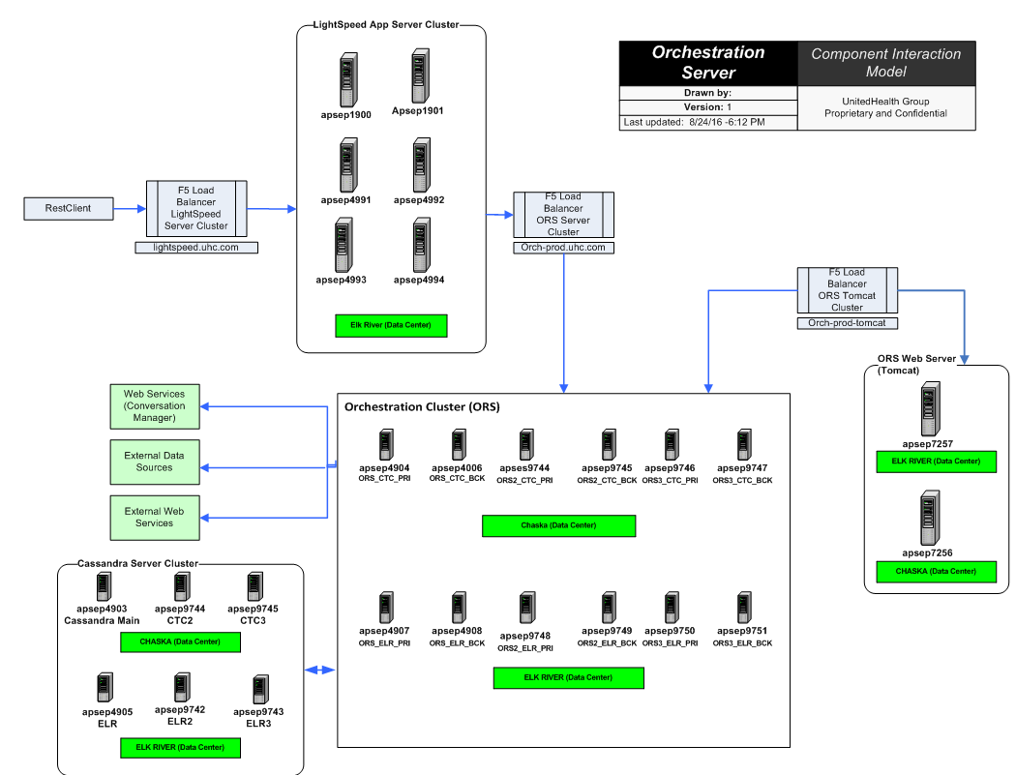
Product Diagram(s) *From Basic 1&2*

Slide 7
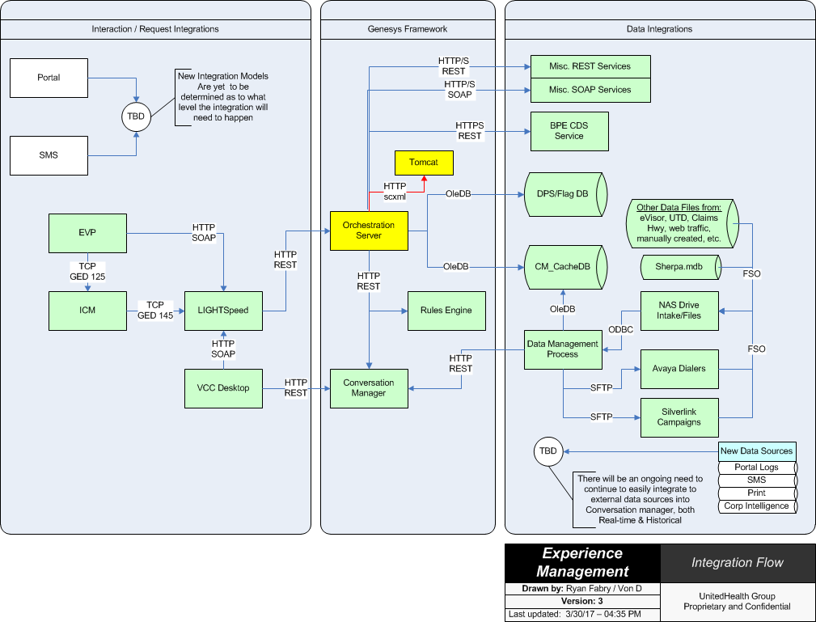
Environment overviews (SDLC)

Slide 8
Environment overviews (SDLC)
Orchestration Server Environment

Slide 9
Environment overviews (SDLC)
Tomcat Server Environment

Slide 10
Example issue/request and requirements
Request to invoke an Orchestration Server (ORS) script requires 2 steps.
First is a HTTP POST request to initiate a Session and return a SessionID
This initializes the script by retrieving all the dependent objects like the workflow scxml files and server pages. It prepares the session with the input parameters received and waits for the 2nd step.
(Typically takes anywhere from 30ms ~ 300ms)
Second is a HTTP GET with the SessionID as part of the RESTful URI.
The GET request uses the previous SessionID retrieved from the POST request and instructs ORS to execute the script.
(Could take as much as 3,000 – 4,000ms)

Slide 11
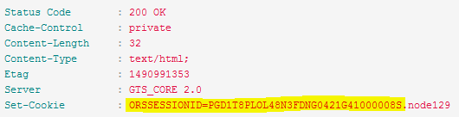
Example issue/request and requirements (cont.)
A member calls into the IVR and is presented with the Repeat Caller Conversation Manager campaign.
IVR Calls a LIGHTSpeed script passing in Member Info
LIGHTSpeed calls the associated ORS Script, first using the POST method and passing into ORS the script name along with all the member information
LIGHTSpeed receives a SessionID back from the POST
LIGHTSpeed turns around and makes a second call to ORS using the GET method with the SessionID
Endpoint: | http://orch-stage.uhc.com:3030/scxml/session/start
Method: | POST
Header: | Content-Type: application/x-www-form-urlencoded
Body: | src=http://orch-stage-tomcat.uhc.com:8080/IVR_EandI_MEMS/src-gen/IPD_IVR_EandI_MEMS.scxml&MID=123456789&DOB=19990101&Fname=JOHN&Policy=7654321&ANI=1234567890&UCID=12345678901234567890
Endpoint: | http://orch-stage.uhc.com:3030/scxml/session/PGD1T8PLOL48N3FDNG0421G41000008S/request/request.process
Method: | GET
Header:
Body:

Slide 12
Example issue/request and requirements (cont.)
A member calls into the IVR and is presented with the Repeat Caller Conversation Manager campaign. (continued)
LIGHTSpeed receives the JSON output from the executed ORS script
Response JSON…
{
"MenuType": “1",
"ProgramCode": “NAV",
"CampaignCode": “RPT",
"ProductType": "MD",
"QuestionType": “R3",
"WavName": "RPT_R3",
"TTS": "I see you called recently. Are you calling for the same reason?",
"AgtExt": "2017-03-31T14:19:49.000Z",
"XferWav": "",
"XferTTS": ""
}
LIGHTSpeed returns the response to the IVR

Slide 13
How To:
What do I need access to?
Global Groups:
Primary ID - UHT_VCCEEM_Users
Secondary ID - UHT_VCCEEM_Users_ARK
Where to I request access from?
Secure: https://secure.uhc.com/
How do I log in?
Remote Desktop (RDC) to server for Log access.
Access each ORS Server at HTTP Port 3030 to view server statistics.
Ex: http://apses2891:3030/
How do I build the solution to #4?
Assumptions/pre-requisites
Genesys Composer
Eclipse IDE – Mars Version 2.0
JDK 1.8.0_51
Genesys Composer Plug-In Version 8.1.400.36 (available through the App Store)
Mozilla FireFox and RESTClient Add-On installed. Mozilla FireFox 38.0.1 is available from the App Store. Once installed the RESTClient can be installed from the Tools / Add-ons Menu. Search for RESTClient and install.

Slide 14
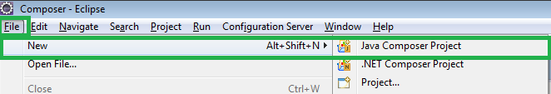
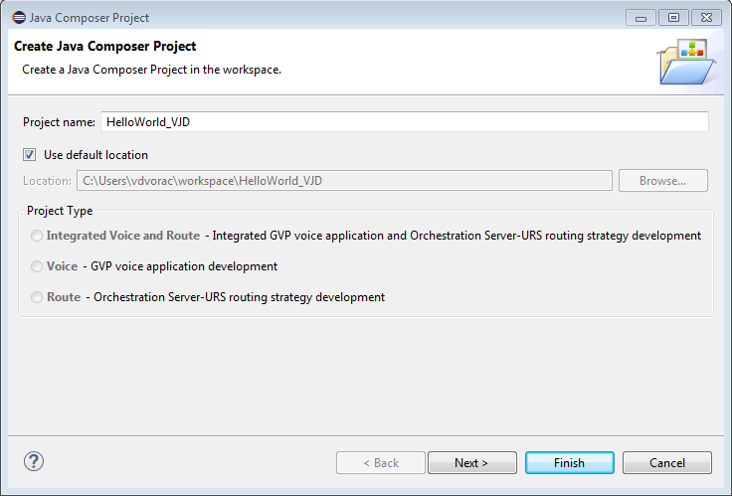
How To:
Step-by-Step instructions (Hello World ORS Script)
Open Eclipse
Click File → New → Java Composer Project
Provide a name for the Project. Name it “HelloWorld_” + Your Initials. I named my project “HelloWorld_VJD” below

Slide 15
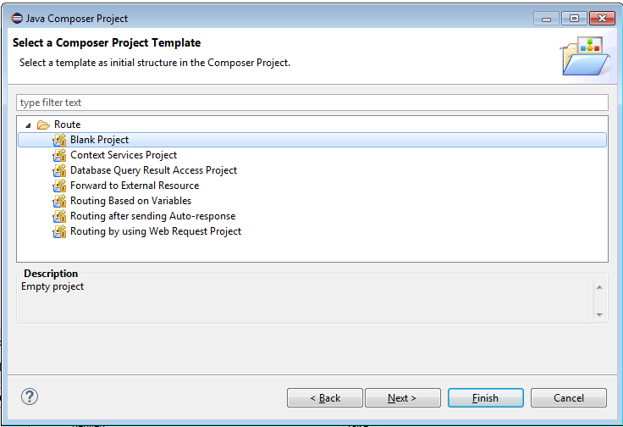
How To:
Click the Next Button and Select “Blank Project”, then click Finish

Slide 16
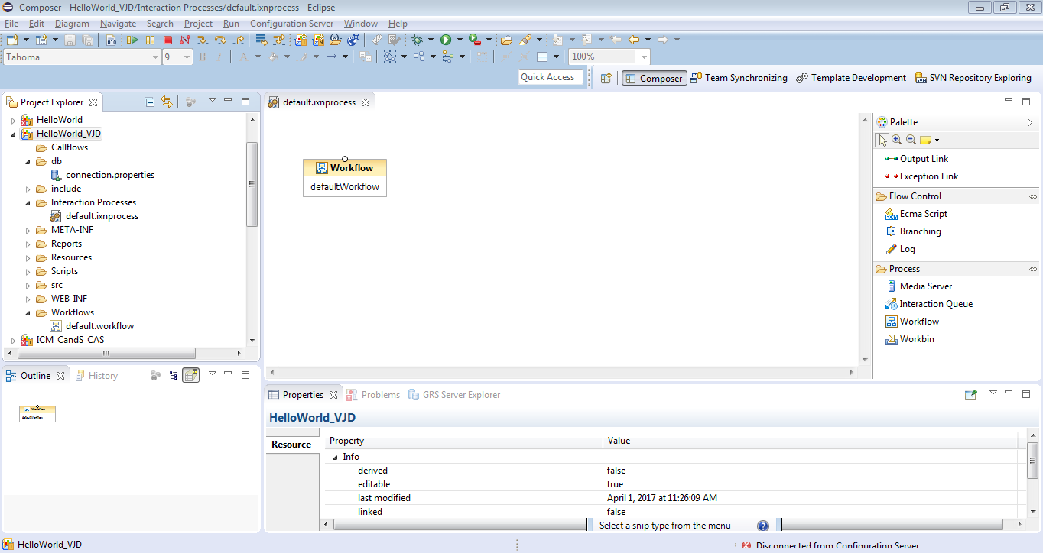
How To:
A new blank “HelloWorld” project will be created with a default Interaction Process and default Workflow

Slide 17
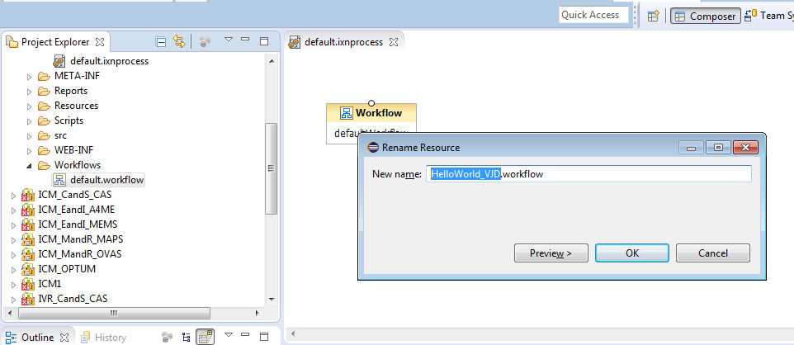
How To:
Rename the default workflow to match the script name. Right-click on the default.workflow item underneath the Workflows directory located in the Solutions Explorer window on the left
Select the “Rename” option (F2) and replace “default” with “HelloWorld_” + Your Initials
Select OK

Slide 18
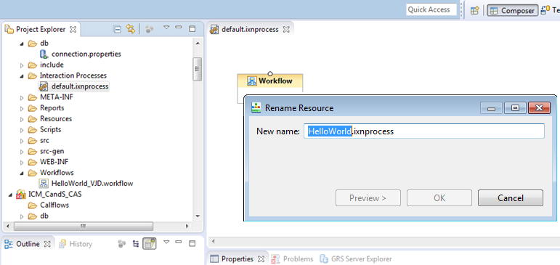
How To:
The default project workflow has now been renamed
Rename the default.ixnprocess in a similar fashion. Right-click on the default.ixnprocess object underneath the Interaction Processes folder and select “Rename” (F2)
Rename this to just “HelloWorld” without your initials, select OK

Slide 19
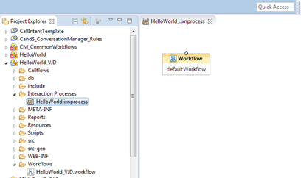
How To:
The default project interaction process has now been renamed
Before we can start building our script (aka workflow), we have to do a few more things to our Interaction Process. First we need to re-associate our workflow. Previously the default.workflow was associated to the Interaction, but we renamed our workflow to “HelloWorld_VJD”, so we must update the workflow reference to reflect the new workflow name.
Click on the Workflow box in the HelloWorld.ixnprocess script canvas window. If the window is not visible, or open, double-click on the HelloWorld.ixnprocess object in the Project Explorer window on the left.

Slide 20
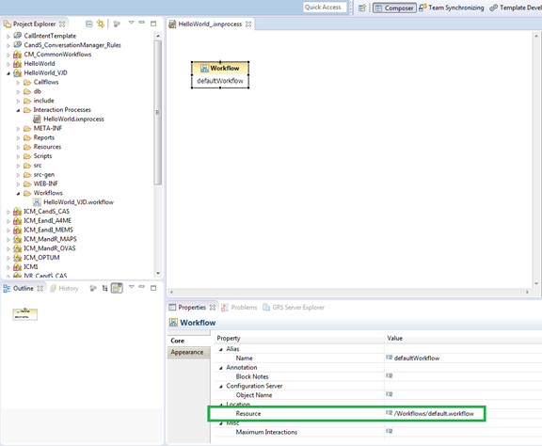
How To:
In the Workflow Property window (bottom), locate the Location/Resource section and click in the Value section to change the assigned workflow.

Slide 21
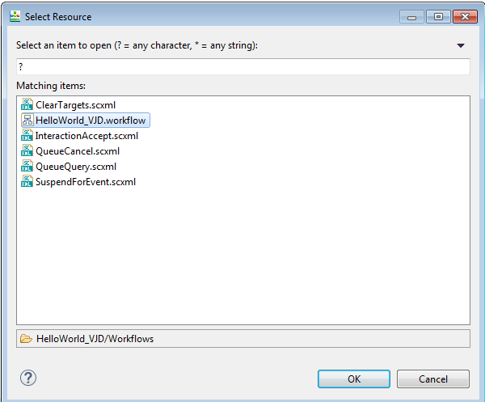
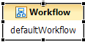
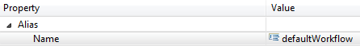
How To:
Select the icon and select the HelloWorld workflow from the available list, select OK
Now rename the Workflow box to your initials.
Select the Workflow element
Change defaultWorkflow to your initials in the Alias\Name property of the Property Window.

Slide 22
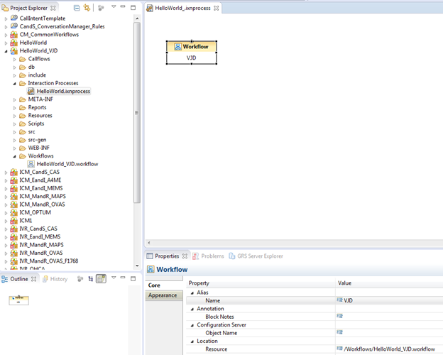
How To:
Your project should now look something like…

Slide 23
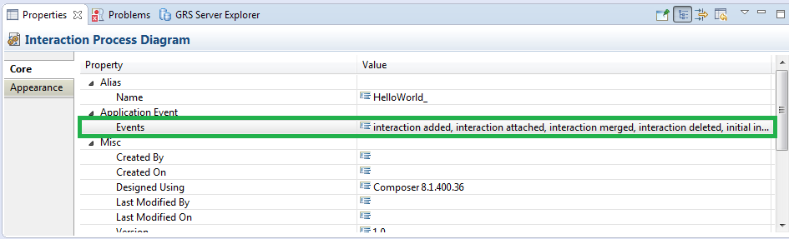
How To:
The last thing we need to do within our Interaction Process is define the script Application Events- this adds the proper event handler(s) to the script that defines how it is to be used. For our ORS “Data Flow” scripts, we will use the Interaction-Less Processing event only. Setting the event to Interaction-Less Processing allows us to call the script, execute it, and close the session. Additional interactions, outside of the initial request/execution, are not supported.
Select anywhere in the white area of the canvas to expose the Interaction Process Diagram’s properties window
Select the Application Event/Events section

Slide 24
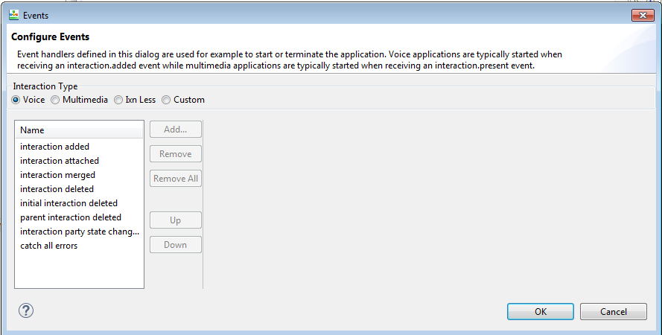
How To:
Select the icon to open the Configure Events window

Slide 25
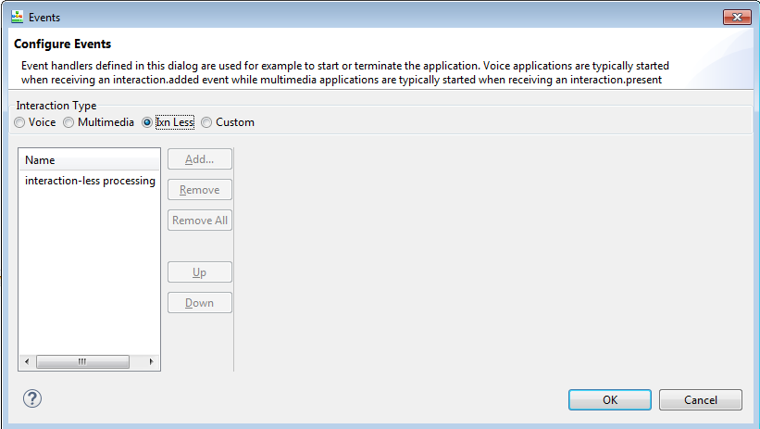
How To:
Select the ”Ixn Less” radio button
Click the OK button
Save your changes using either the Save Icon or the File → Save menu

Slide 26
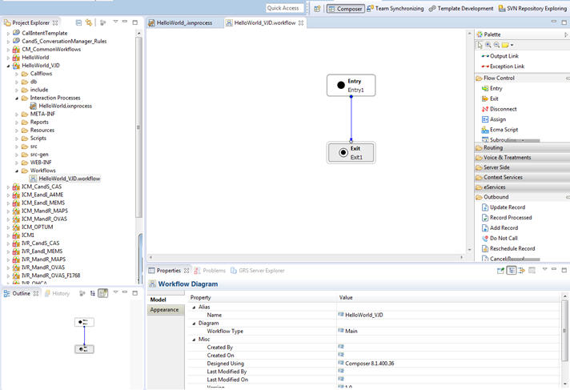
How To:
Now we’re ready to build script out our Hello World script. Double-Click on the HelloWorld_*.worflow file underneath the Workflows folder.

Slide 27
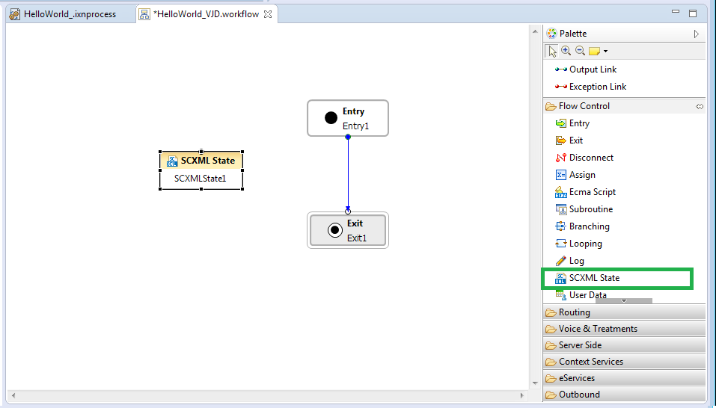
How To:
From the Palette Window on the right-hand side, expand the “Flow Control” section, locate the “SCXML State” item and drag and drop it onto the canvas

Slide 28
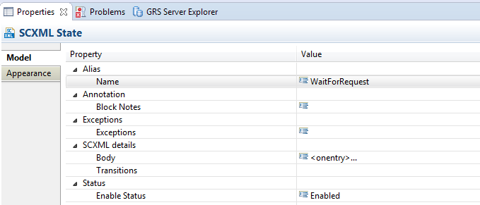
How To:
The SCXML State block will act as the starting point for our script by configuring a new Transitions item. This is where we designate the phrase within our GET URL which will trigger the script execution. We use the phrase request.process in our all ORS scripts, so we’ll do the same here.
Click on the SCXML State block and go down to the Properties window, within the Alias/Name section, rename the block to something more meaningful like WaitForRequest.
(Note that spaces are not allowed in the Block Names)

Slide 29
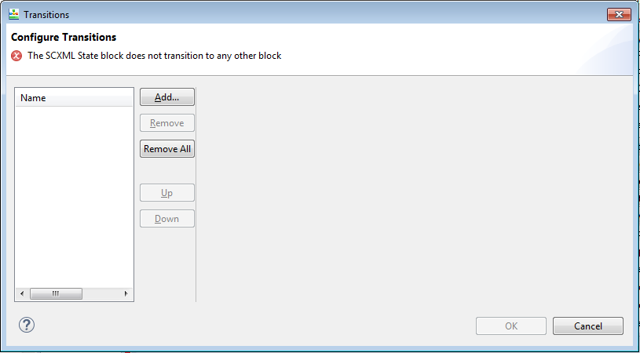
How To:
Select the SCXML details/Transitions section and then click the icon to open Configure Transitions window.

Slide 30
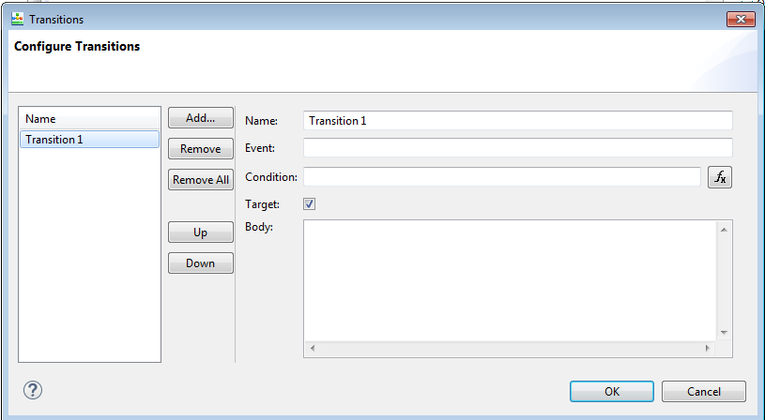
How To:
Select the Add button

Slide 31
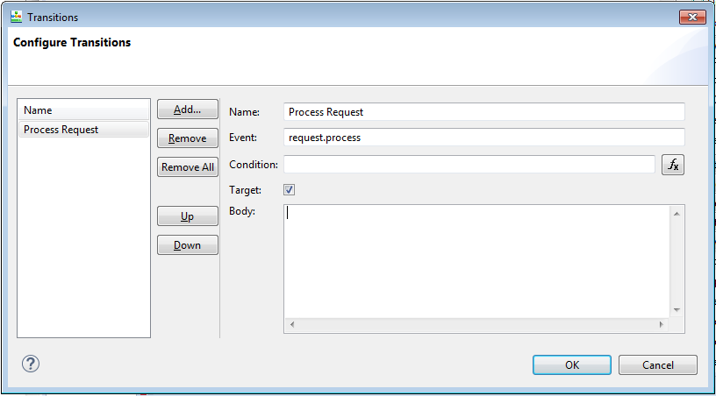
How To:
Rename the transition from “Transition 1” to “Process Request” and add the phrase “request.process” to the “Event” section.
Select OK

Slide 32
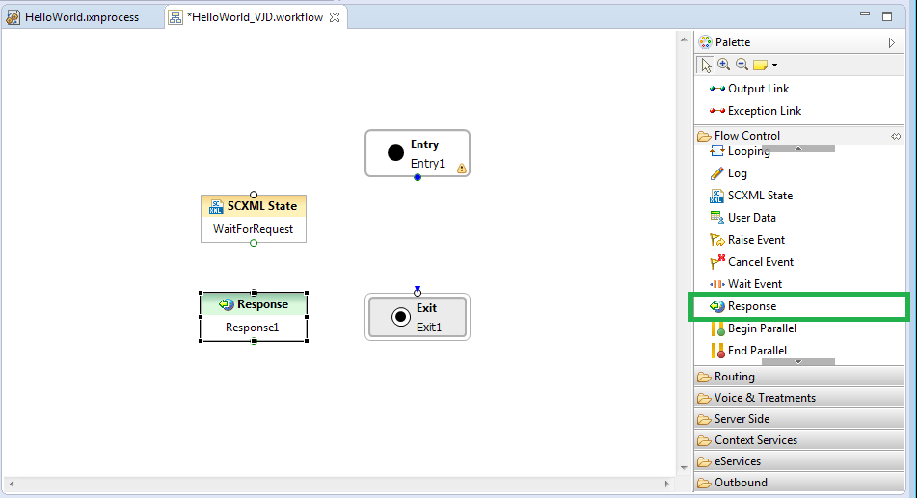
How To:
Add a “Response” block to the script. A Response block is used to send data back to the calling application; the response. From the Palette Window on the right-hand side, locate the “Response” item and drag and drop it onto the canvas

Slide 33
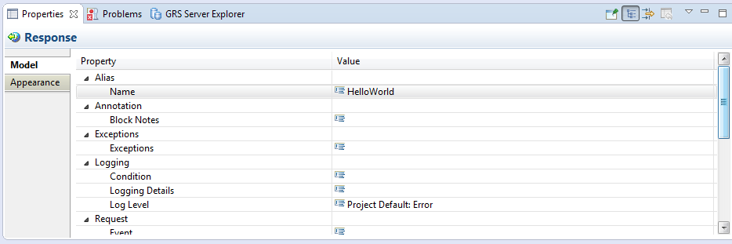
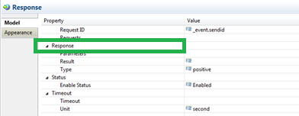
How To:
Click on the Response block and go down to the Properties window, within the Alias/Name section, rename the block to something more meaningful like HelloWorld.
(Note that spaces are not allowed in the Block Names)
Scroll down the Property window to the “Response” section.

Slide 34
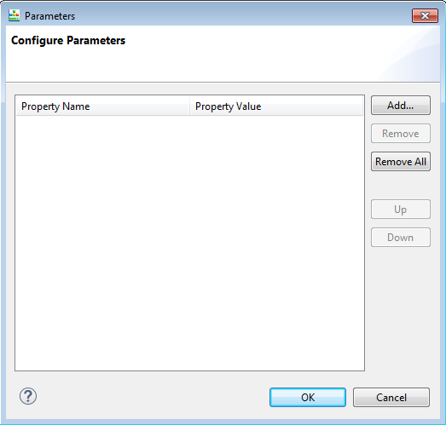
How To:
Select the Response/Parameters section and then click the icon to open the Configure Parameters window.

Slide 35
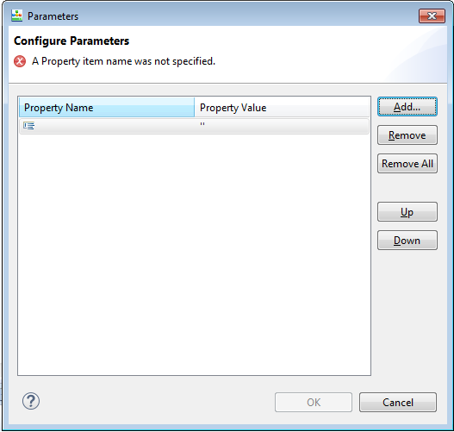
How To:
Select the Add button to add a new Response property
The “Property Name” section is where we name our individual response element. The “Property Value” section holds the value for the response element. Property Values may be either static text or mapped to a variable.

Slide 36
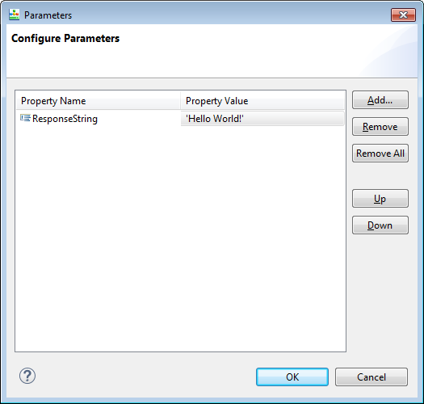
How To:
Give the “Property Name” the value of “ResponseString” and the “Property Value” the value of 'Hello World!' with single quotes.
(Note that the “Property Value” contains a qualified single-quoted string using Java-Script notation)
Select OK

Slide 37
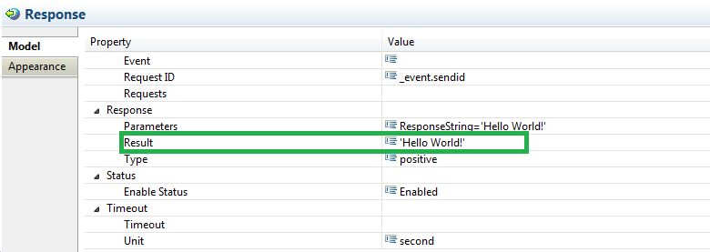
How To:
Before we finish up with the Response object, add the 'Hello World!' string to the Response/Result section, once again using the single-quote qualifier.
(Note the value contains a qualified single-quoted string using Java-Script notation)

Slide 38
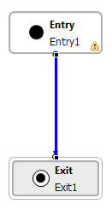
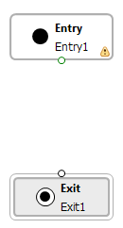
How To:
Finish up the script by connecting the blocks together. Start with the current Entry block, click on the blue line that connects the Entry block to the Exit block
With the line selected, press the Delete key on the keyboard to remove the current connection

Slide 39
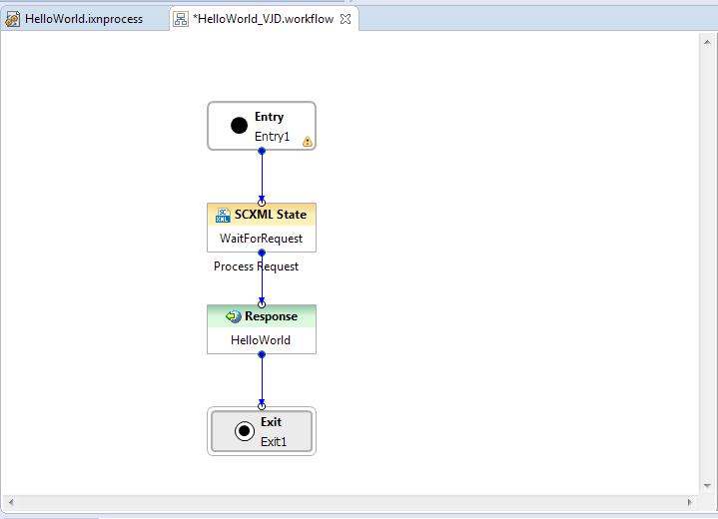
How To:
Re-arrange the blocks on the screen in the order we want the script to flow with the Entry block first, followed by the SCXML State block, Response block and finally the Exit block.
Connect the blocks together by clicking the lower circle of one block and dragging the line to the upper circle of the next block. Repeat this process for all 4 blocks.

Slide 40
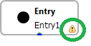
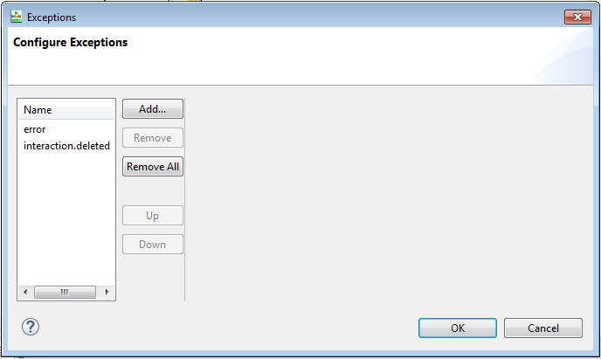
How To:
While we are technically done writing our script and could easily compile and execute the script, there is one last thing to address. You may have noticed a Caution sign on the Entry block. This is a composer warning indicating we have an un-caught exception that should be properly handled. Handling this exception will ensure we can safely exit our script in the event of an error. Not addressing this exception could leave our script in a non-responsive state, consuming resources on the server and potentially negatively impacting the system.
Click on the Entry block and go to the Properties window, locate the Exceptions section and select the Exceptions/Exceptions section, then click the icon to open Configure Exceptions window.

Slide 41
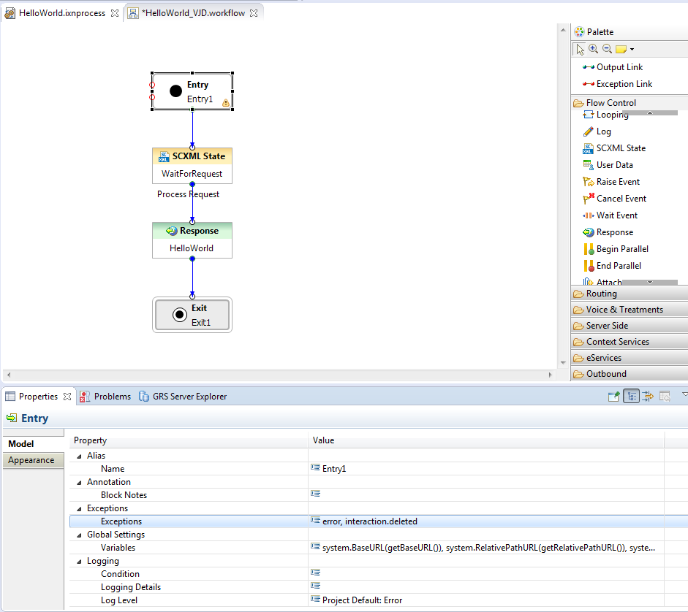
How To:
Select OK

Slide 42
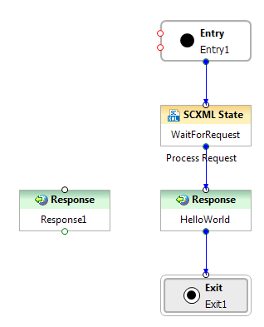
How To:
There are now 2 red circles on the left side of the Entry block; one for each exception. These need to connect to somewhere, so we’re going to add a 2nd Response block to our script that will be used to return an error condition back to the calling application. Drag and drop a Response item onto the script canvas.
Rename the Response block to something more meaningful, like Exception_HelloWorld. (refer to instruction ii – kk for adding and renaming a Response block)

Slide 43
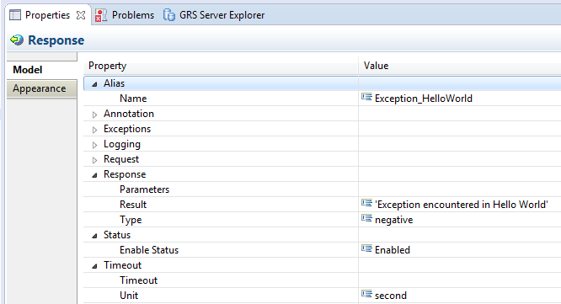
How To:
Scroll down the Response block property window until you get to the Response section. Add the string 'Exception encountered in Hello World' to the Response/Result section and change the Response/Type from positive to negative. The negative response type returns a HTTP Status Code of 500 (Internal Server Error), while the positive response type returns a HTTP Status Code of 200 (OK). The Response/Result value is returned as the HTTP Reason-Phrase.

Slide 44
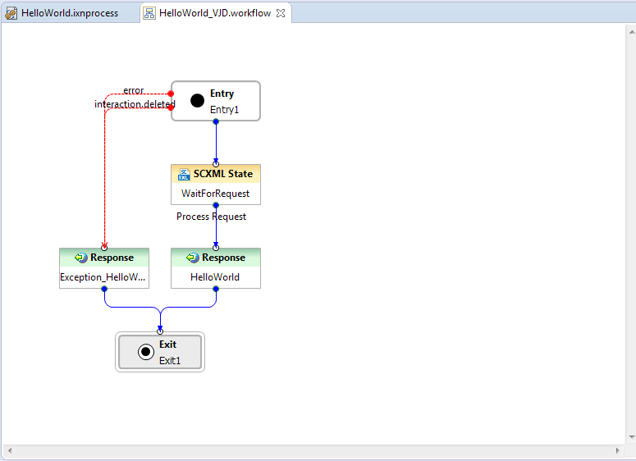
How To:
Connect both of the red exception circles on the left side of the Entry block to the newly created Exception_HelloWorld Response block, then connect the Response block to the Exit block.
Save your changes using either the Save Icon or the File → Save menu
The warning icon is no longer displayed on our Entry block and we’re now ready to test our script

Slide 45
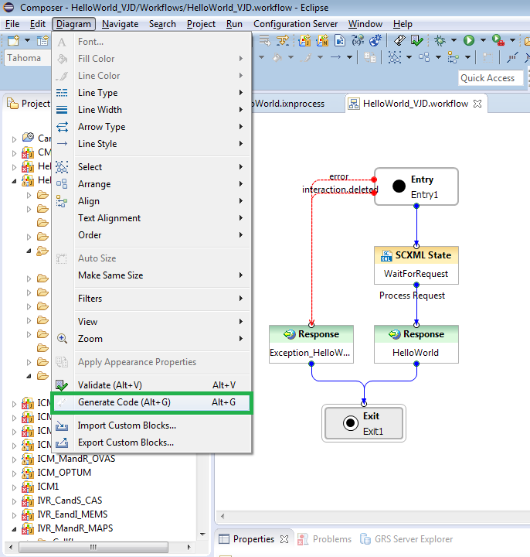
How To:
How do I save it?
Up to this point, we’ve made several changes and saved them all, however all the changes are saved locally within Composer. In order to actually run and test the script, we need to convert it to scxml. We do this using the Generate Code (Alt + G) method from the Diagram menu.

Slide 46
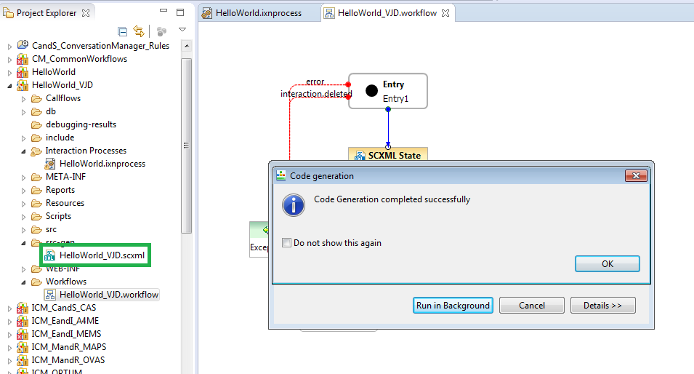
How To:
With the HelloWorld workflow open, select the Diagram → Generate Code (Alt + G) menu option

Slide 47
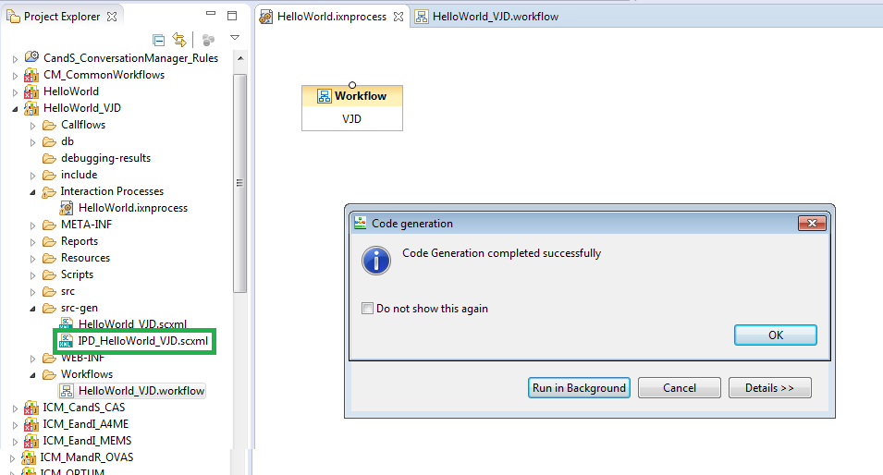
How To:
Select OK to dismiss the previous message box
Switch to the HelloWorld Interaction Process diagram (HelloWorld.ixnprocess) and select the Diagram → Generate Code (Alt + G) menu option

Slide 48
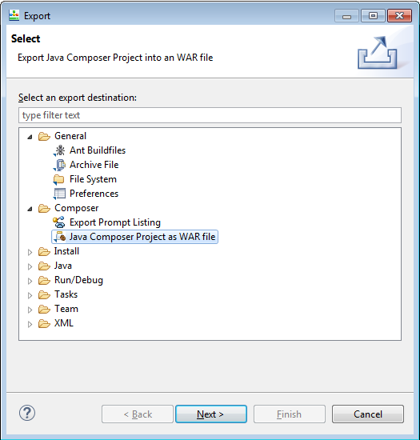
How To:
Select OK to dismiss the previous message box
Now that we have converted our script to .scxml we can use the Export function to create a .war file that can be deployed to a Tomcat server. From the File Menu, select Export
Underneath the Composer folder, select “Java Composer Project as WAR file” and select the Next button.

Slide 49
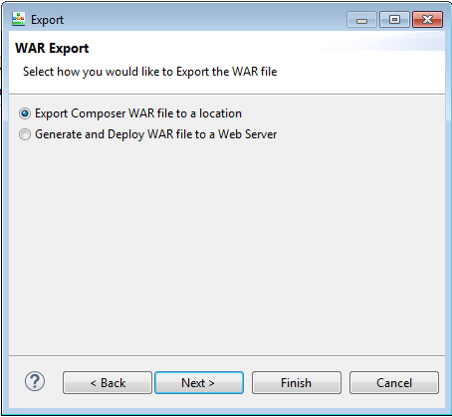
How To:
Continue on with the “Export Composer WAR file to a location” radio button selected and press the Next button

Slide 50
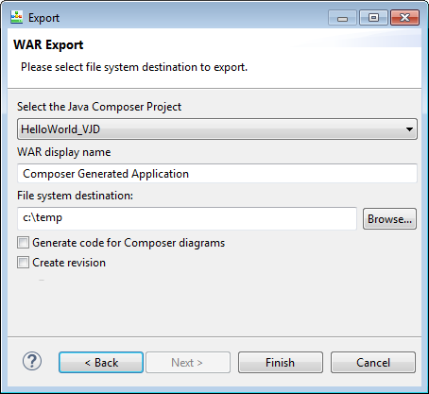
How To:
Press the Finish button to create a .war file. Note the destination folder, this is where the .war file will be saved.

Slide 51
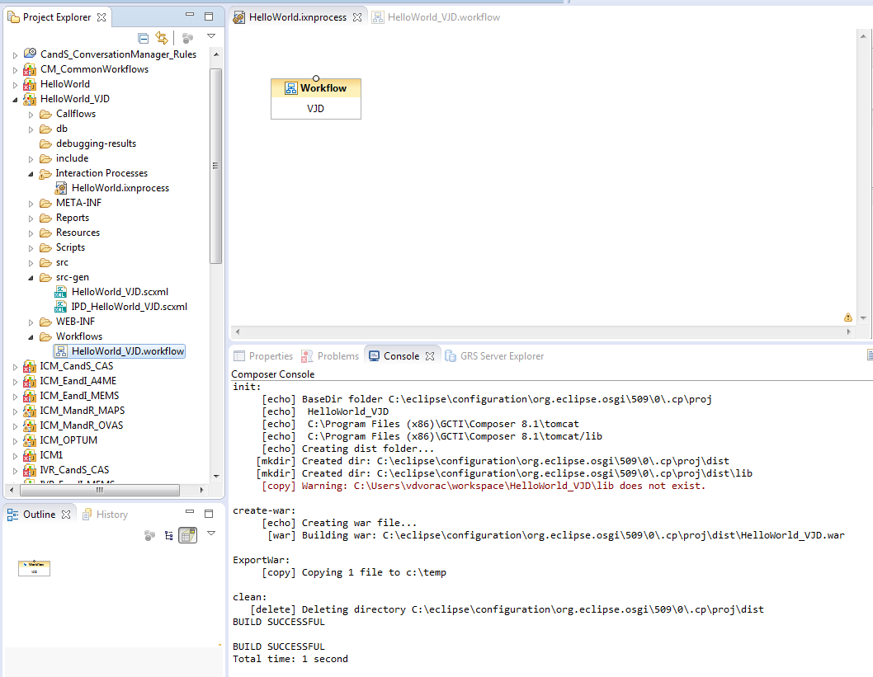
How To:
As the project is exported, log entries are written to the Console tab towards the bottom. Review the output to make sure the .war file was properly built and exported

Slide 52
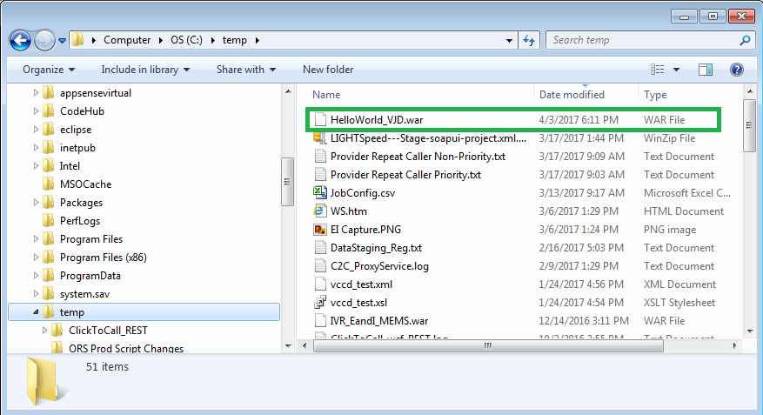
How To:
Check the destination folder for the HelloWorld_VJD.war file.
The .war file is a compressed file that contains our .scxml files and all the dependent objects needed to run our script.

Slide 53
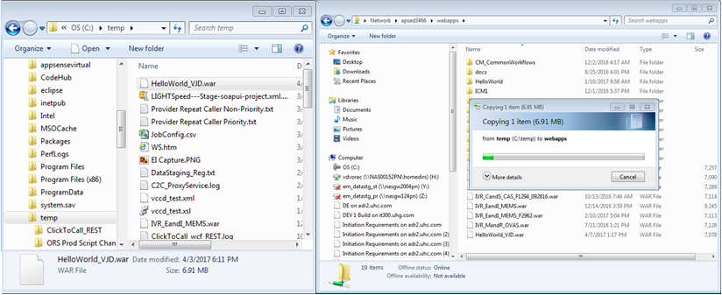
How To:
To deploy the HelloWorld script, simply copy and paste the .war file to the webapps directory of a Tomcat server. Once copied, Tomcat will de-compress the file and deploy the script.
Browse to the Dev/Test Tomcat server; \\apsed3466\webapps\
Copy the HelloWorld .war file from the destination directory on your local machine to the Dev/Test Tomcat server.

Slide 54
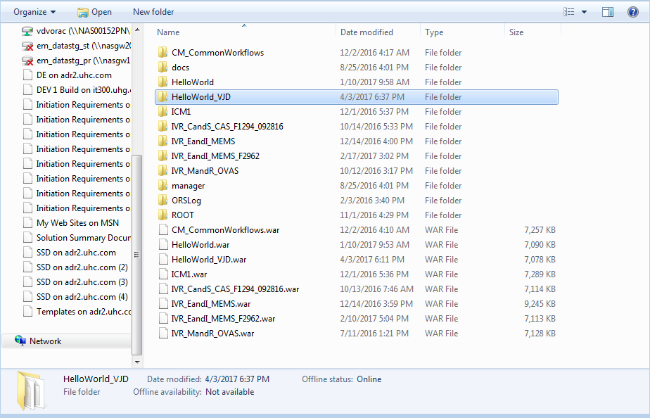


How To:
Tomcat will create a new sub-folder underneath the webapps folder. Verify the folder is there and that the .scxml files are in the src-gen sub sub-folder.

Slide 55


How To:
Congratulations! The script has been successfully deployed.
You can verify this by browsing to the .scxml files in a web browser
http://apsed3466:8080/HelloWorld_VJD/src-gen/IPD_HelloWorld_VJD.scxml
http://apsed3466:8080/HelloWorld_VJD/src-gen/HelloWorld_VJD.scxml

Slide 56

How To:
How do I test it?
Execute the script using FireFox and the RESTClient
From within the FireFox browser, select the RESTClient from the Tools Menu
Add the Dev/Test Orchestration Server “POST” URI http://apsed3218:3030/scxml/session/start to the URL section
Change the Method to “POST”
Add a new Custom Header from the Headers toolbar
Request Header Name: Content-Type
Request Header Value: application/x-www-form-urlencoded

Slide 57

How To:
Add the HelloWorld IPD script reference to the Request Body
src=http://apsed3466:8080/HelloWorld_VJD/src-gen/IPD_HelloWorld_VJD.scxml

Slide 58

How To:
Press the SEND button

Slide 59

How To:
Switch over to one of the Response Body tabs and copy the string in the Response
The Response string is the ORS Session ID needed to execute the script using the GET Method. Construct a new URL using the string http://apsed3218:3030/scxml/session/{SESSIONID}/request/request.process substituting {SESSION} with the Session ID string from the response.
Change the URL to http://apsed3218:3030/scxml/session/O0JCUQKO2D28166Q5VJH7T9KOK00003V/request/request.process
Change the Method to “GET”

Slide 60


How To:
Press the SEND button
Note the Status Code of 200 OK and the Reason-Phrase is Hello World!

Slide 61

How To:
Review the output in the Response Body. Select the Response Body (Preview) tab to see the JSON response.

Slide 62
How To:
How do I migrate it to the next environment/prod
To promote from Dev/Test to Stage, copy the .war file from the Dev/Test Tomcat server to the Stage Tomcat Servers.
(Refer to the Tomcat Server Environment slide for a list of Tomcat Servers)
To promote from Stage to Prod, copy the .war file from a Stage Tomcat server to the Production Tomcat Servers.
(Refer to the Tomcat Server Environment slide for a list of Tomcat Servers)

Slide 63

Q & A

